Slide 1
Carbonate Depositional Environments

Slide 2
Knowing where modem carbonates occur, what they
are composed of, and what their controls are is essen-
tial for evaluating microfacies data. The objectives of
this chapter are to summarize the settings and environ-
ments in which carbonate sediments are formed and to
document which classifications are used for differenti-
ating these environments. Emphasis is placed on the
definitions of terms.

Slide 3
Introduction
Microfacies analysis of carbonate rocks requires a knowledge of modern carbonates
and an understanding of biological and
geological changes during earth
history.

Slide 4
Carbonates are Born not Made
This simple phrase by Noel James (1979) highlights
the main theme of carbonate sedimentation and the dif-
ferences between carbonate and siliciclastic sediments.
Carbonates are 'born'. They originate as skeletal grains
or precipitates within the depositional environment. By
contrast, terrigenous clastic sediments are formed pri-
marily by the disintegration of parent rocks and are
transported to the depositional environment.

Slide 5
Shallow-marine carbonate depositional systems dif-
fer fundamentally from siliciclastic depositional sys-
tems in their intrinsic controls, i.e. the growth potential
including the 'aggregation potential' (the ability to grow
vertically and to track sea level) and the 'production
potential' (the ability to produce and export sediment).
The aggradation potential is critical for the history of
carbonate platforms and reefs, the production potential
for the progradation and retreat of platforms. These dif-
ferences are of central importance in the application of
sequence stratigraphy to carbonates (Schlager 1992)

Slide 6
The 'Sorby Principle': Limestones are
Predominantly Biogenic Sediments
Well over 90% or more of the carbonates found in mod-
em marine environments are biological in origin, i.e.
the sediments are biotically induced (by an organic trig-
ger, e.g. microbial micrites) or biotically controlled
(skeletal autotrophic and heterotrophic organisms de-
termine the composition, location and timing of car-
bonate production).

Slide 7
Some of the 'abiotic' carbonate pre-
cipitation (represented by marine cements) is also trig-
gered by organics or the activity of organisms. The
dominant role of organisms in the formation of lime-
stones was recognized as early as 1879 by Henry Clifton
Sorby. Studying Paleozoic, Mesozoic and Tertiary car-
bonate rocks in thin sections, he recognized the over-
whelming abundance of fossils and their importance in
the composition of carbonate sands and muds.

Slide 8
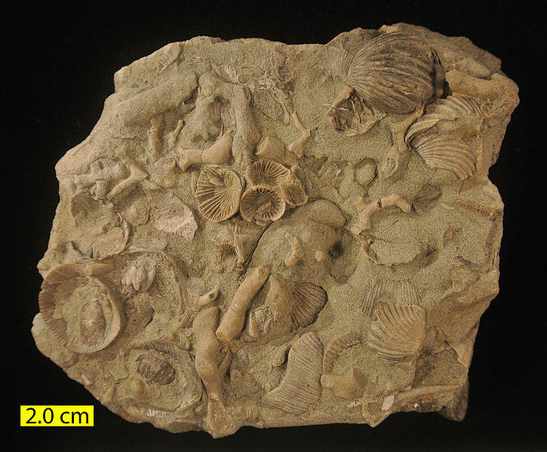
Fossiliferous limestone slab from the Liberty Formation (Upper Ordovician) of Caesar Creek State Park near Waynesville, Ohio.

Slide 9
The distribution and frequency of carbonate-producing organisms depend strongly on environmental factors, such as
light, water temperature and sedimentary influx.
These controls as well as the paleoenvironmental set-
tings are reflected by microfacies criteria and paleon-
tological data.

Slide 10
Modern Carbonates: Obligatory Reading
There is a wealth of well-written reviews and concise
updated syntheses of modem carbonate sediments
The strength of these
papers is that they outline the main criteria of recent
marine and non-marine carbonates and their major con-
trols in the context of interpreting ancient carbonate
rocks.

Slide 11
The information included in these fundamental
texts is crucial for microfacies analyses. The 'Micro-
facies of Carbonate Rocks' does not intend to dupli-
cate this information, but focuses on those data which
are specifically relevant for microfacies studies.

Slide 12
* Carbonate Sedimentation In Marine Environment Based On Biological ,Oceanographical and Topographical Criteria.

Slide 13
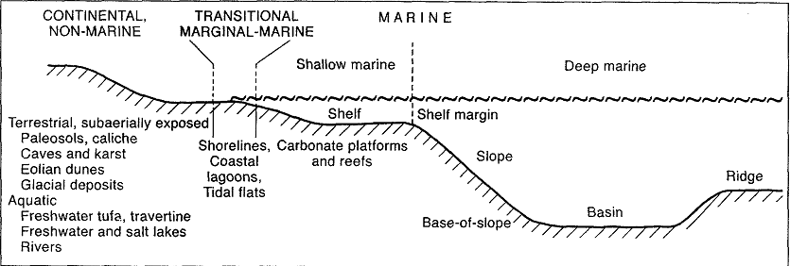
Settings of carbonate depositional environments

Slide 14
Carbonate Sediments Originate
on Land and in the Sea
Classification of Marine
Environments
Boundary Levels
Vertical and Horizontal Zonations

Slide 15
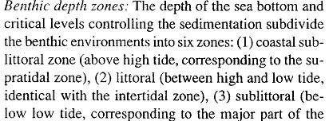
Vertical Zonations

Slide 16
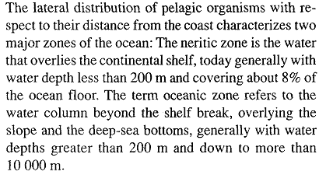
Horizontal Zonations

Slide 18
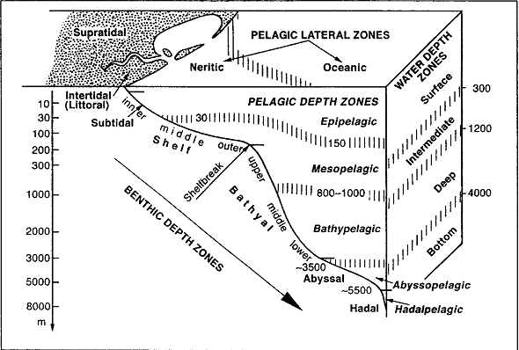
Marine depositional
environments. Modified from
Kennett (1982).

Slide 19
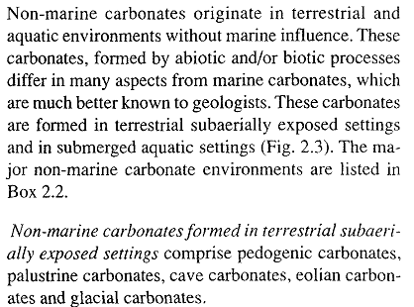
Non-Marine Carbonate Environments

Slide 20
Pedogenic Carbonates, Paleosols, and
CalichelCalcretes

Slide 21
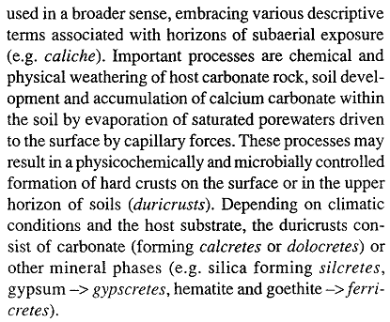

Slide 23
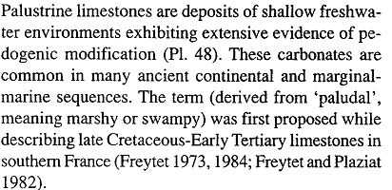
Palustrine Carbonates

Slide 24
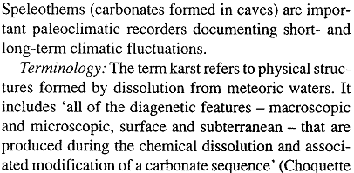
Cave Carbonates, Speleothems and Karst

Slide 25
Eolian Carbonate

Slide 26
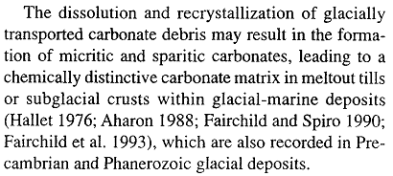
Glacial Carbonates

Slide 27
Travertine, Calcareous Tufa and
Calcareous Sinte

Slide 28
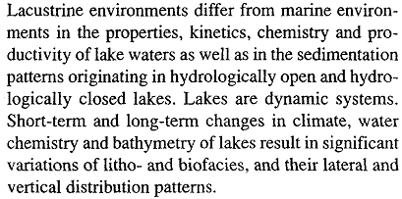
Lacustrine Carbonates: Lakes

Slide 29
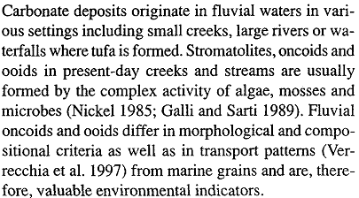
Fluvial Carbonates

Slide 30
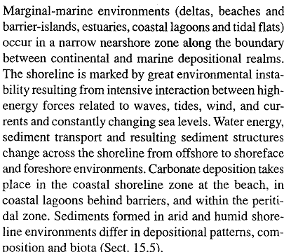
Transitional Marginal-Marine
Environments: Shorelines and Peritidal
Sediments

Slide 31
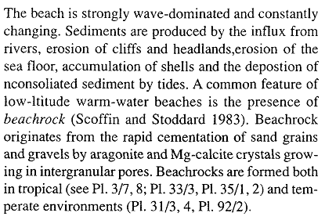
Beach (Foreshore), Barriers and
Coastal Lagoons

Slide 32
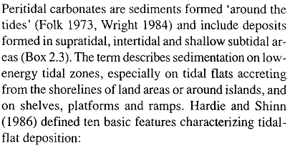
Peritidal Environments

Slide 33
Shallow-Marine Sedimentary
Environments: 'Shallow' and 'Deep'

Slide 34
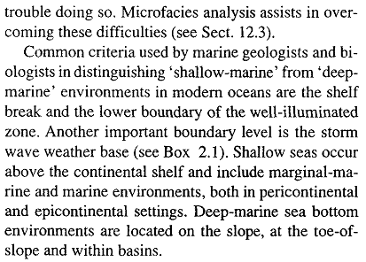

Slide 35
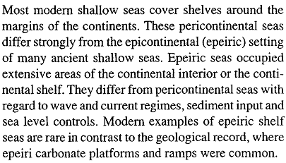
Pericontinental vs Epicontinental
Shallow Seas

Slide 36
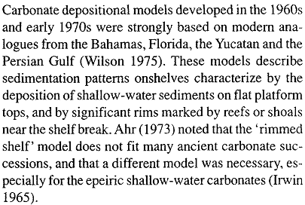
Carbonate Shelves, Ramps and Plat-
forms

Slide 37
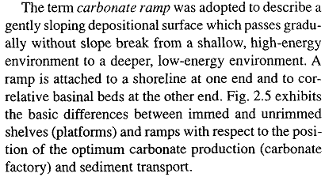

Slide 38
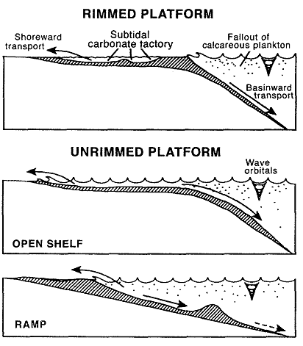

Slide 39
Carbonate platforms: Broad categories.
Rimmed carbonate shelves
Non-rimmed carbonate shelves
Homoclinal ramps
Distally steepened ramps
Epeiric platforms
Isolated platforms
Oceanic atolls
Drowned platforms

Slide 40
Shelf Margins

Slide 41
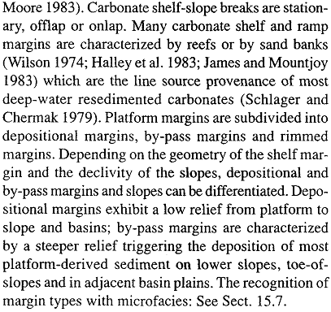

Slide 42
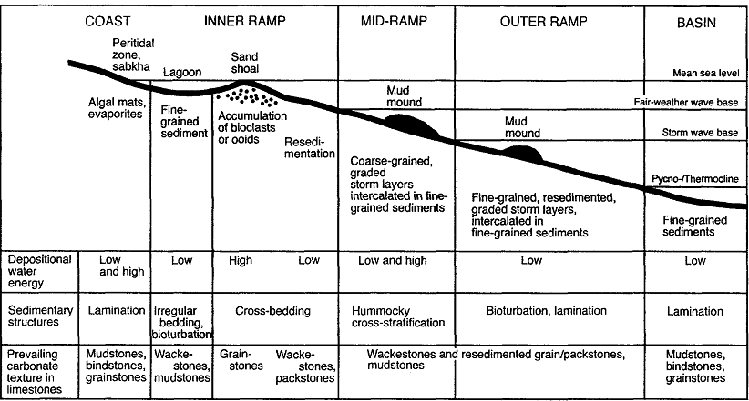
Generalized subdivision of carbonate ramps. Compare with Box 2.4.

Slide 43
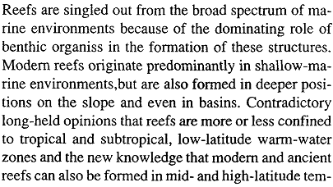
Reefs

Slide 44
Tropical and Non-Tropical Carbonates:
Different in Composition, Controls and
Significance
For a long time modem shelf carbonates have been con-
sidered to be restricted predominantly to warm-water
tropical environments. However, extensive shelf car-

Slide 45
bonates are forming in all latitudes and at warm, cool
and cold water temperatures. Modem non-tropical car-
bonates occur in tidal flats, on shelves and platforms as
well as in the deep sea, similar to tropical shelf carbon-
ates. Tropical carbonates are relatively well understood
and are, therefore, discussed rather briefly in this chap-
ter. The following text concentrates chiefly on non-
tropical shelf and reef carbonates, because microfacies
analysis will have a high potential in the future for rec-
ognizing and evaluating ancient temperate and cool-
water limestones

Slide 46
Carbonate occur in
1- Eulittoral and supralittoral env. ( principally in tropical and subtropical env.)
2- Sublittoral env. (in water depth approximately between (20-200 m) (shelf and shelf margin)
3- deep sea (down to the calcite compensation depth between 4000- 5000 m (primarily planktonic sedimentation )

Slide 47
Basic oceanographical classification
chart

Slide 48
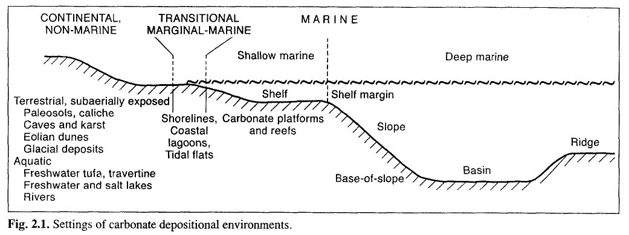
Setting of carbonate depositional environments

Slide 49
Sublittoral
Eulittoral
Carboate Sedimentation Env.
Deep Sea
Lake & terrestrial

Slide 50
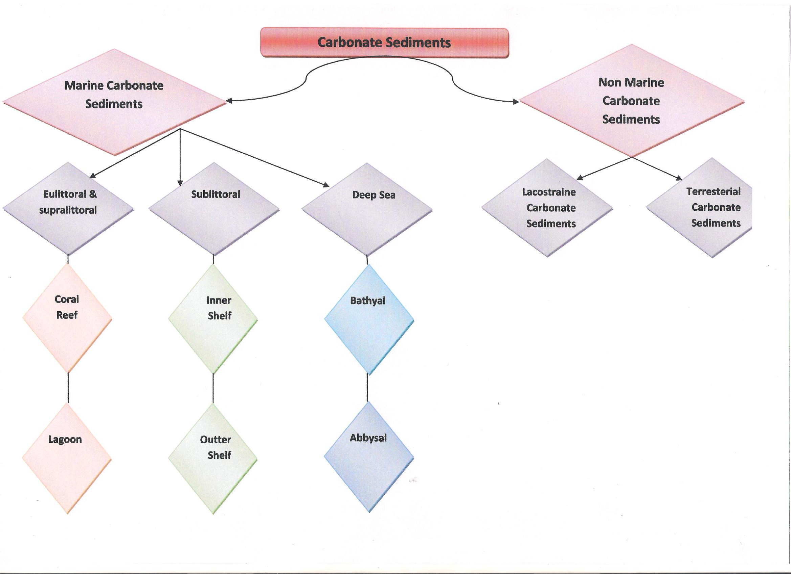

Slide 53
Questions

